Slide 1


SafeSymp: A RAG-Based Symptom & Self-Care Guidance Assistant
Team Members:
- Mahitha Donti Reddy
- Naveen Yadav Dadi
- Naveen Reddy Velumala
Course: DSCI 6004 – NLP

Slide 2

Project Topic & Domain
Domain: Consumer Health Information
Corpus: MedlinePlus Health Topics XML (NIH)
Optional: openFDA Drug Label API
Focus: Safe symptom education (no diagnosis/prescriptions)

Slide 3
Project Objectives
Build
Build RAG system for safe symptom guidance
Provide
Provide self-care & diet suggestions
Highlight
Highlight red-flag conditions
Compare
Compare 3 open-source LLMs
Ensure
Ensure strict safety guardrails

Slide 4
Statement of Value
Online health info is often misleading
LLMs may produce unsafe hallucinations
Grounding + safety filters reduce risk
Helps users make informed care decisions

Slide 5

State of the Art (RAG Systems)
RAG (Lewis et al., 2020): Retrieval reduces hallucination
RETRO (DeepMind, 2022): Large retrieval memory improves reasoning
DPR (Karpukhin et al., 2020): Dense retrieval increases relevance

Slide 6
State of the Art (Healthcare LLM Safety)
• Med-PaLM 2: High QA accuracy but safety issues
• BlenderBot 3: Conversational grounding, still inconsistent
Conclusion: Safety guardrails are essential

Slide 7
Approach & Architecture
Models:
Phi-3-mini (microsoft/Phi-3-mini-4k-instruct),
TinyLlama-1.1B (TinyLlama/TinyLlama-1.1B-Chat-v1.0),
Qwen-1.8B-Chat (Qwen/Qwen1.5-1.8B-Chat)
Retrieval: TF-IDF or embeddings over MedlinePlus
Pipeline:
User Input → Safety Filter → Retrieval → LLM → Post-processing → Output

Slide 8
Deliverables
Colab-based RAG system
Demo Video & Report
Dataset & prompt set (≥10 queries)
Model comparison report
Final presentation & GitHub repo

Slide 9
Evaluation Methodology
Grounding score (% supported claims)
Hallucination rate
Safety violation checks
User clarity rating
Runtime comparison across LLMs

Slide 10


Slide 11
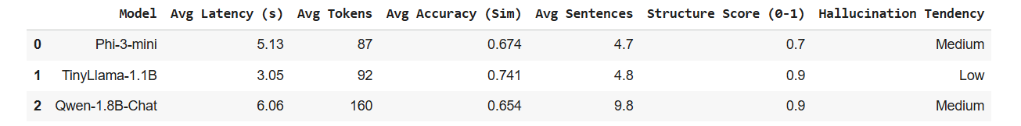
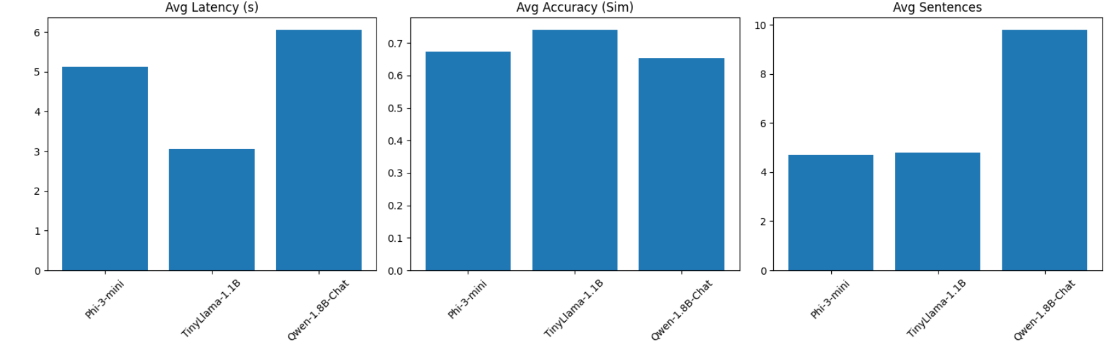
Model Comparison Table

Slide 12
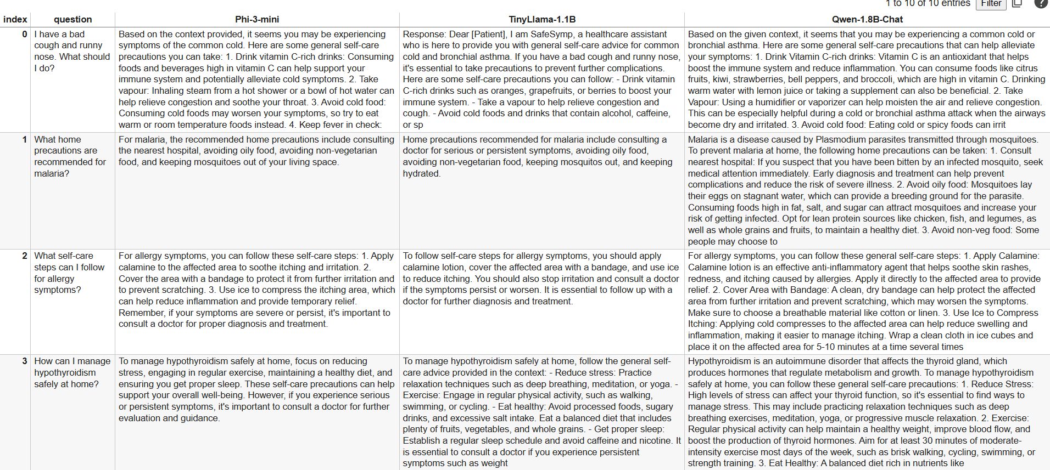
Results

Slide 13
Qualitative Approach Differences
Phi-3-mini: - Medium hallucination (based on doc similarity - **NOTE: Accuracy now reflects whether grounding context was available and used.**). - Concise style (avg 4.7 sentences/query). - Structured responses (70% with lists).
TinyLlama-1.1B: - Low hallucination (based on doc similarity - **NOTE: Accuracy now reflects whether grounding context was available and used.**). - Concise style (avg 4.8 sentences/query). - Structured responses (90% with lists).
Qwen-1.8B-Chat: - Medium hallucination (based on doc similarity - **NOTE: Accuracy now reflects whether grounding context was available and used.**). - Verbose style (avg 9.8 sentences/query). - Structured responses (90% with lists).

Slide 14


THANK YOU

